Slide 1
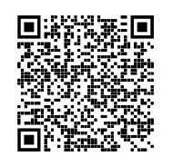
Women in Computer Science @ Pitt!
Interest Meeting (8/29)
Sign in here —>

Slide 2
Meet our Officers!
Anita Kaul- President
Shreya Agrawal- Vice President
Allison Briggs- Business Manager
Aditi Junagade- Marketing Manager
Madeline Fontana- Events Planner

Slide 3
What we do
WiCS is a space for women in tech or supporters of the movement to come together and support each other and advance our careers in a very male dominated field!
GBM time for Fall Semester: Thursdays at 7pm, 5317 Sennott Square
-Technical Events
-Social Events
-Collaborations with other clubs

Slide 4
Technical Events
Workshops
LinkedIn, Github, Resume, Intro to API’s, Leetcode Night, Mock Interviews
Sponsor events
Meet with recruiters, send in resume on Discord
Mentorship program
Upperclassmen and underclassmen paired together!
Spill the Tea
Electives, classes, profs to take

Slide 5
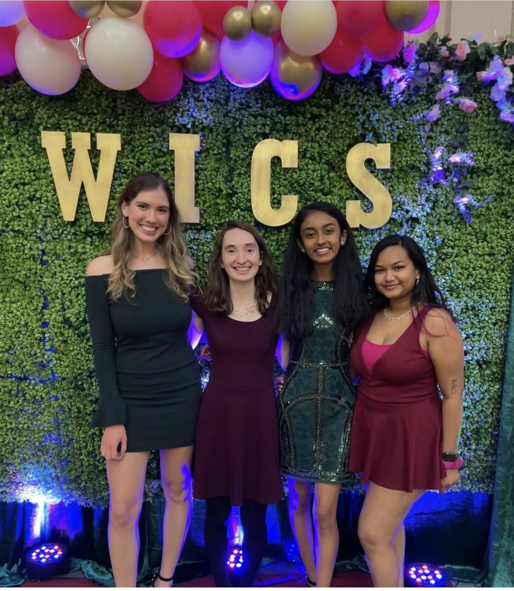
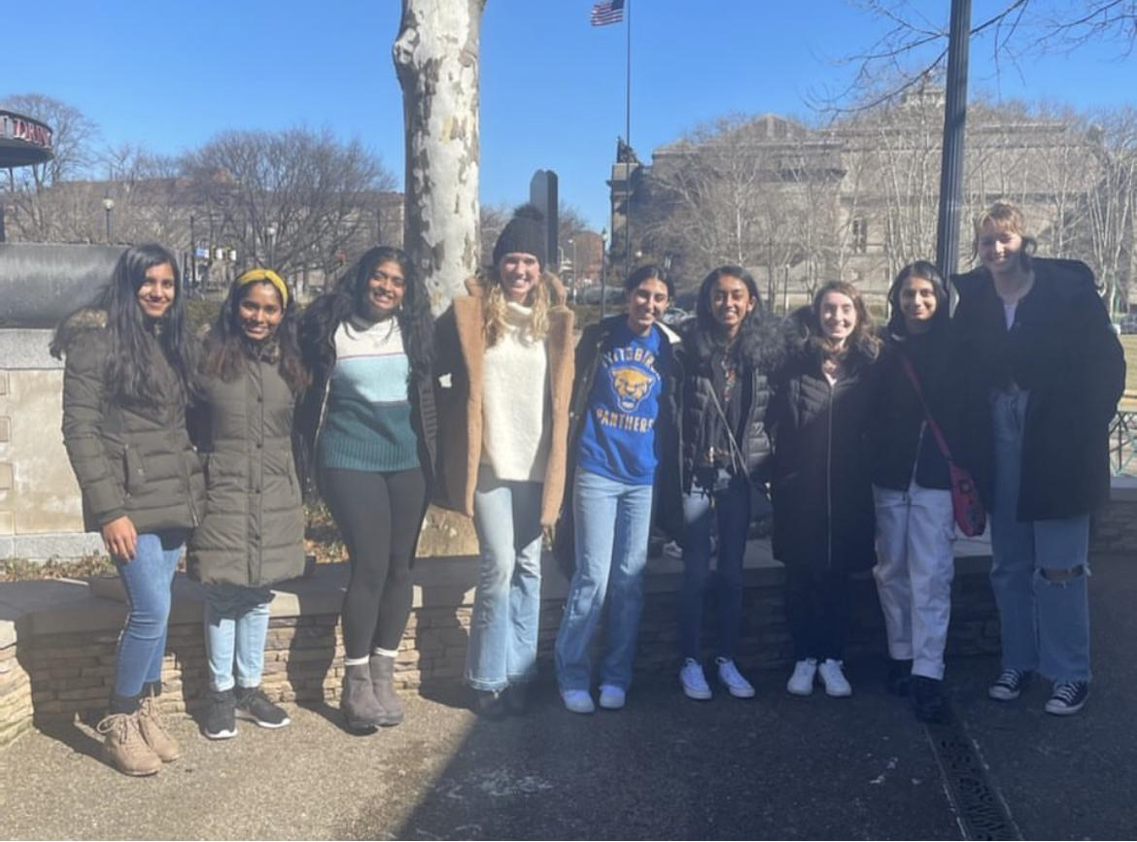
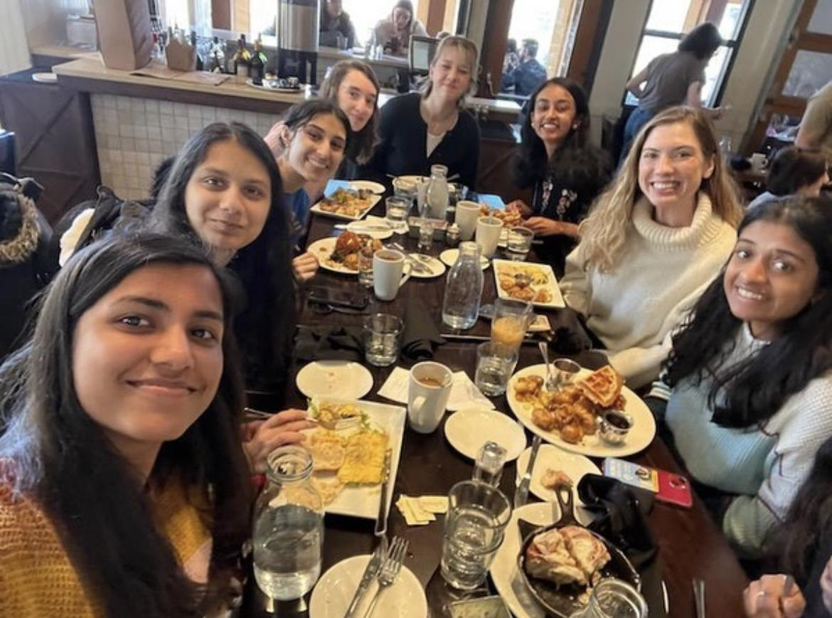
Social Events
Bring your own work
Go to brunch, museums
Formal
Collabs with CSC and MAC
Halloween and Christmas Party!

Slide 6

Our Sponsors

Slide 7
Subsections in Tech!
Game Development
Web Development
AI & Machine Learning
UX Design
Algo-Trading
Software Engineering (Back-end)
Cybersecurity
Full Stack
Front End
Information Technology
Robotics

Slide 8
Our goals this year
Interactive, go into college with solid goals and sustainable goals, feel prepared for a career in tech
Main components in a tech career:
-Intern/co-op
-Take core classes
-Networking
-Starting Passion Projects

Slide 9
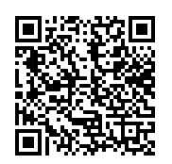
And now…
If you’d like to connect with others in the same classes with you, scan this QR code:

Slide 10
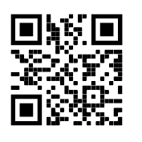
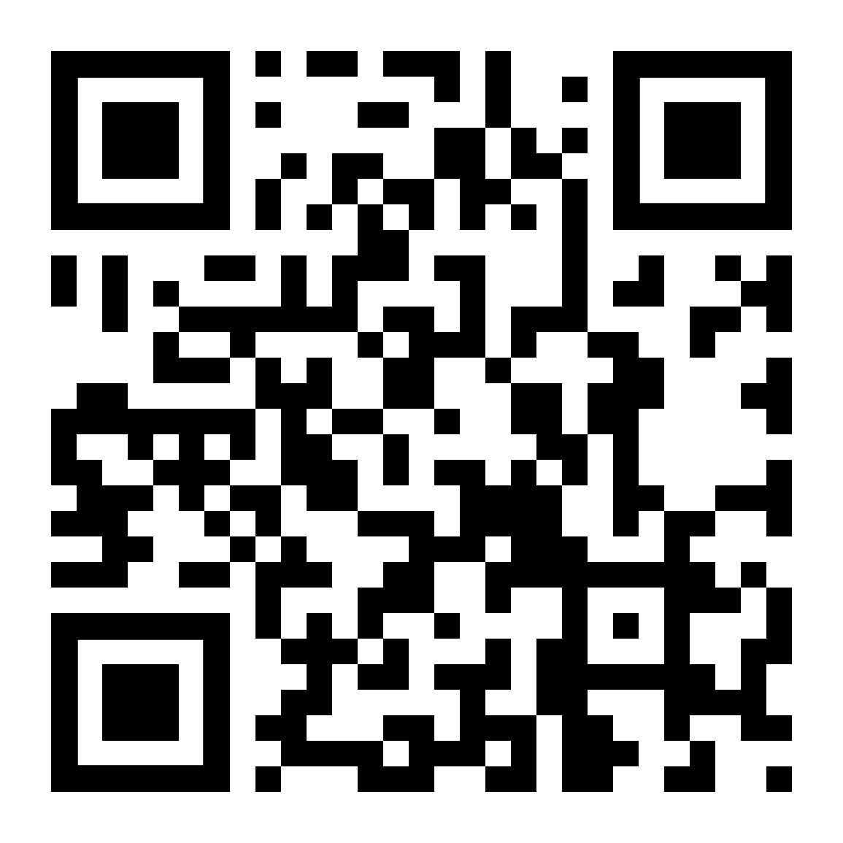

Our socials!
Mailing List
Discord
Instagram

